Slide 1

Art Concierge & Advisory Service

Slide 2

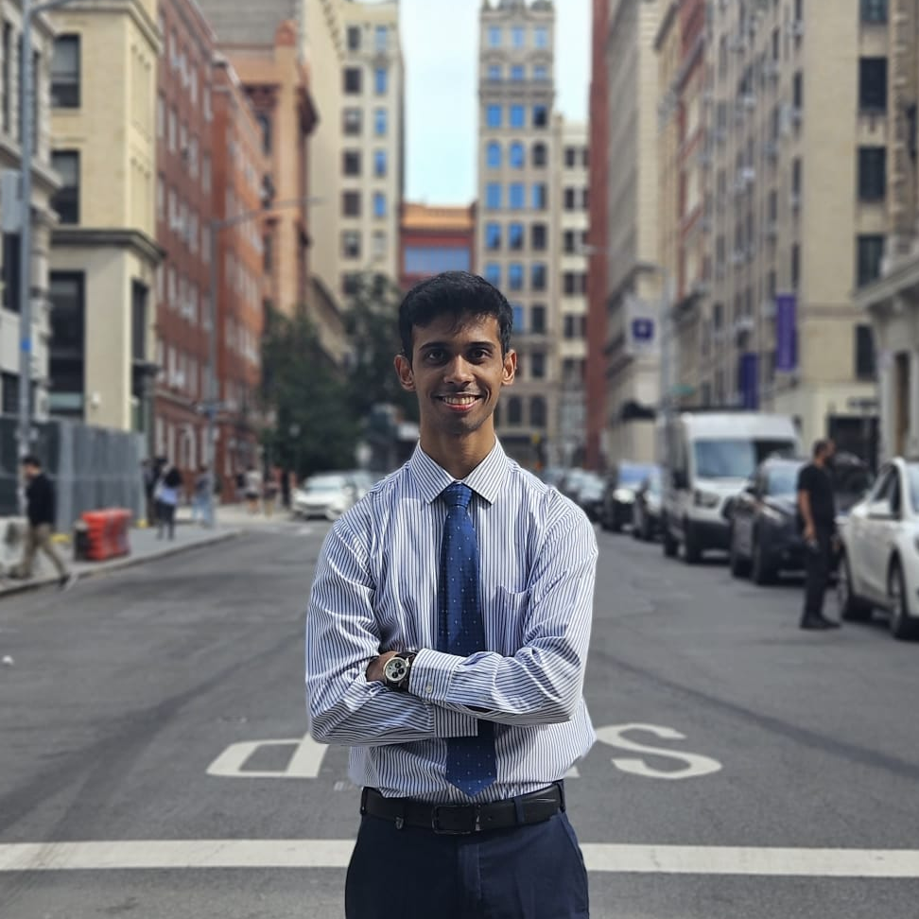



ONER Team
Justin Hwang
Product Manager
Data Engineer
NYU Computer Science M.S
Yash Mathur
Software Engineer
Backend Developer
NYU Computer Science M.S
Tajeshu Mutte
Data Engineer
NYU Computer Science M.S
Lucy Shi
Backend Developer
NYU Computer Science M.S
Samuel Vieira Restrepo
Frontend Developer
NYU Computer Science M.S

Slide 3
Overview
1
2
3
4
5
Problem Statement
Use Cases & Solution
System Architecture
Implementation
Conclusion

Slide 4
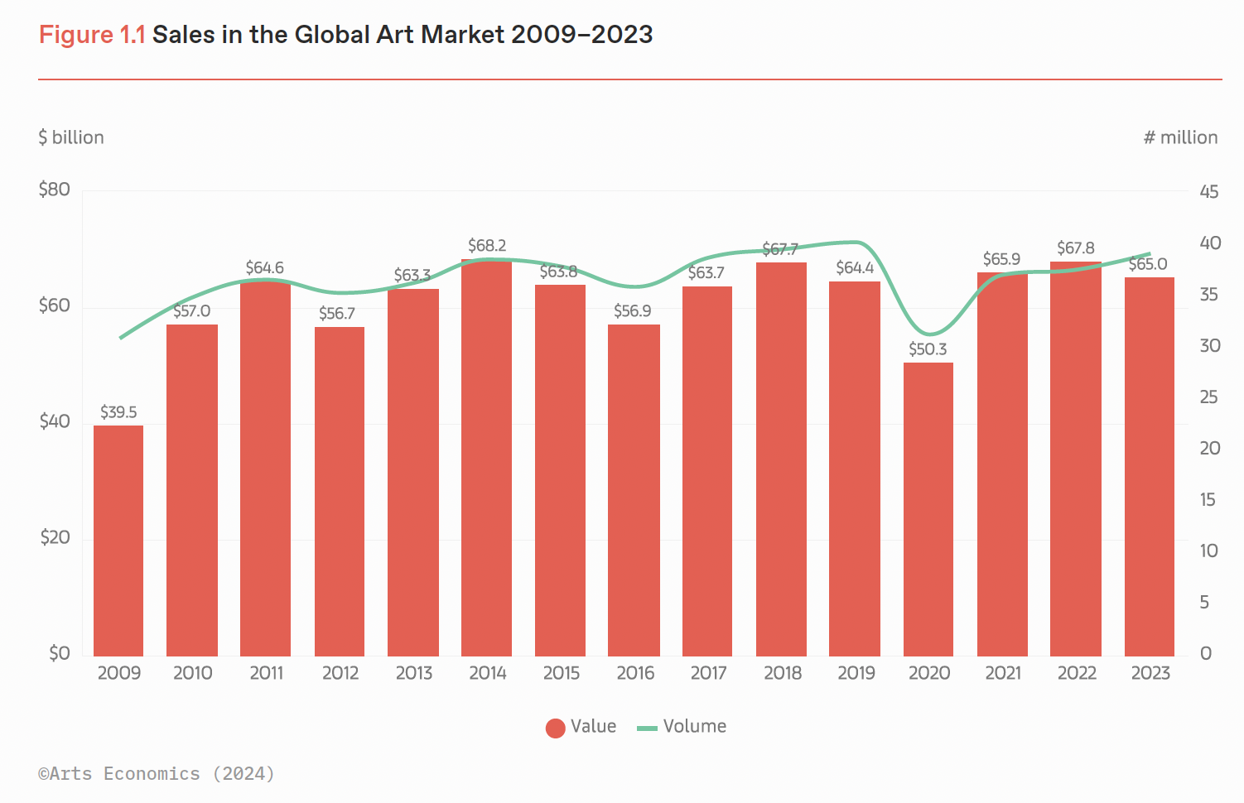
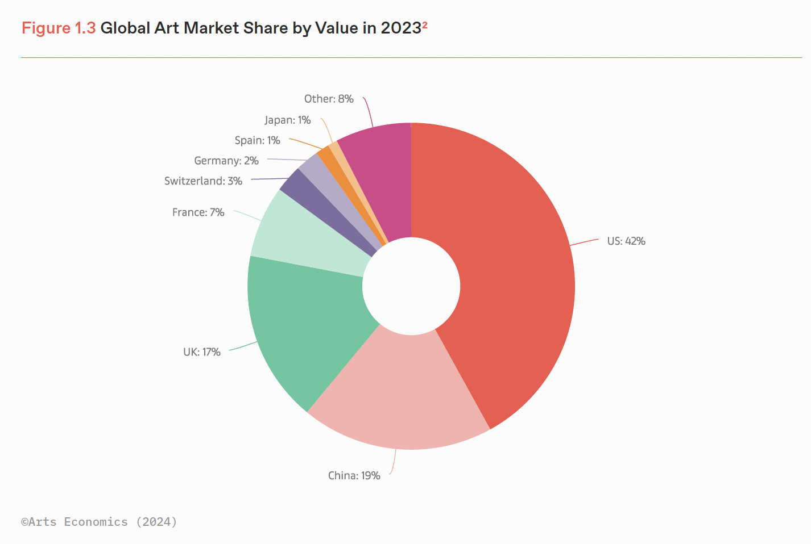
1.1 Market Trend
The global art market has experienced consistent growth since 2009. Although the market size temporarily declined due to the COVID-19 pandemic, it quickly recovered to its original size and has maintained its scale since then.
In 2023, the United States accounted for 42% of the global art market by value, representing the highest percentage compared to any other country.
Reference: The Art Basel & UBS; Art Market Report 2024 by ARTS ECONOMICS

Slide 5
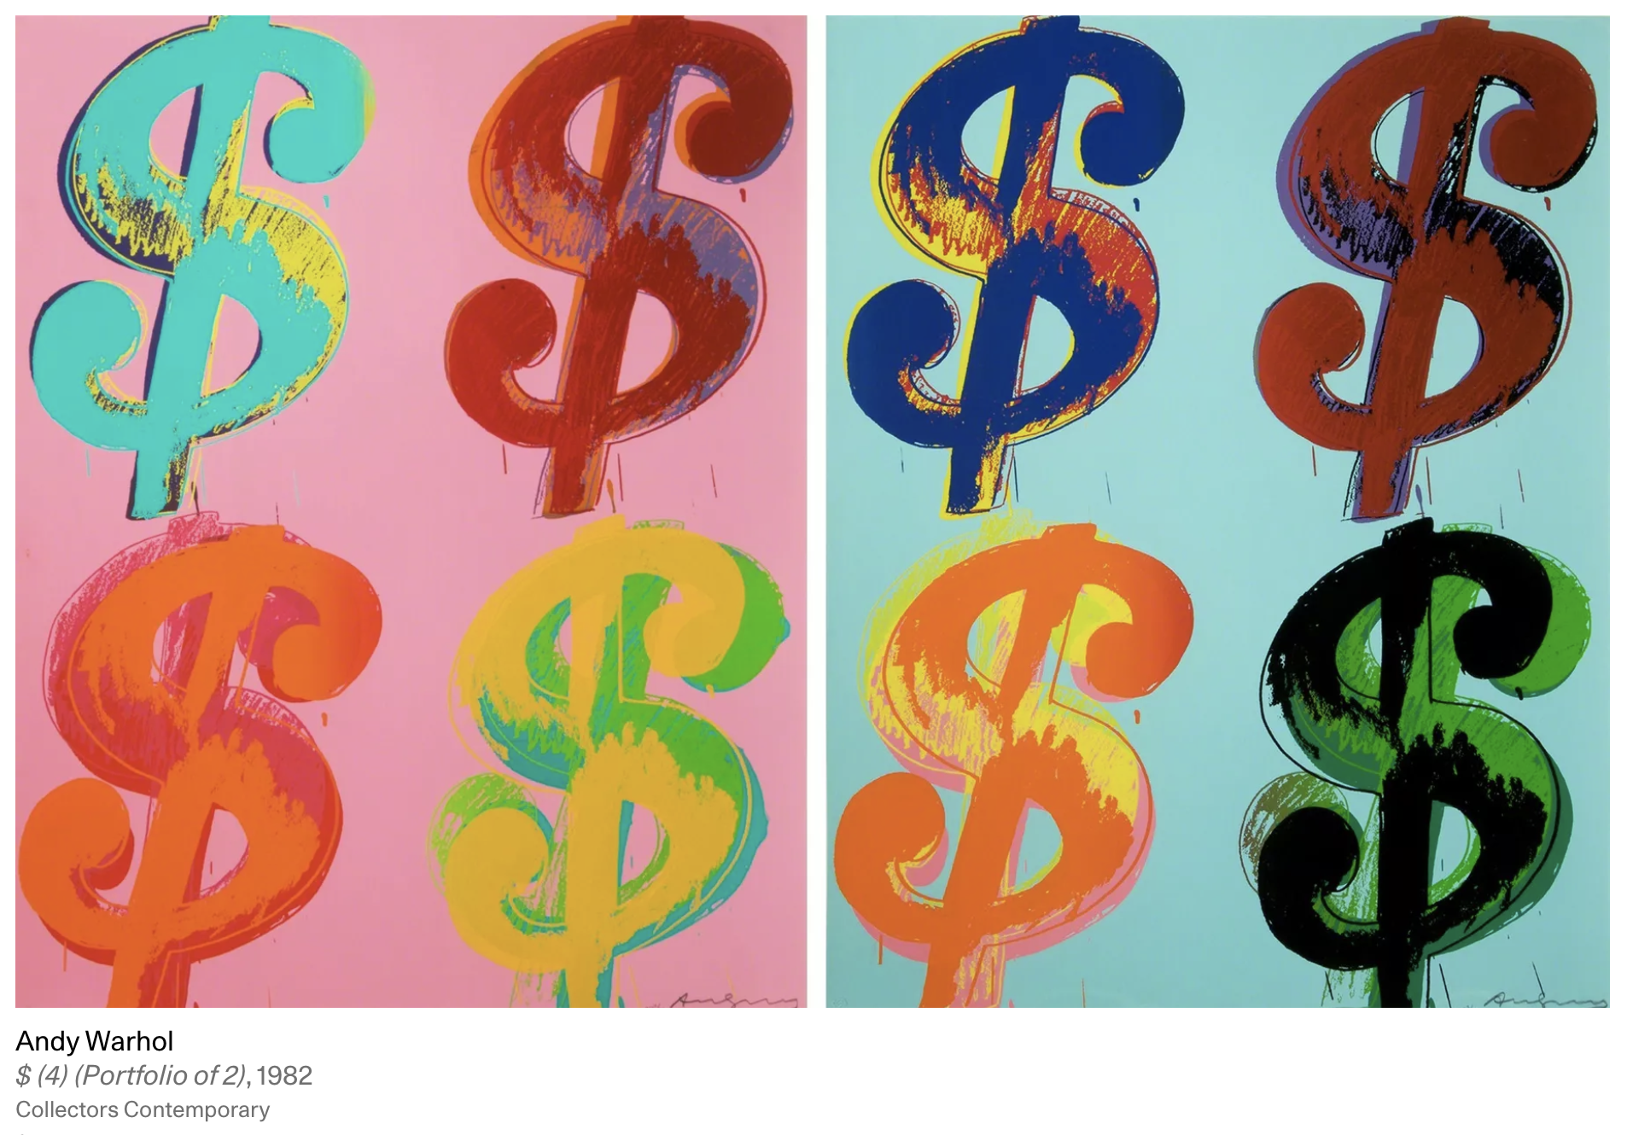
1.2 Problem Statement
Despite the substantial growth and economic significance of the global art market, many investors lack a deep understanding of their personal art preferences. This gap in knowledge presents a challenge for individuals looking to make informed investments in art pieces. Consequently, there is a clear demand for analytical tools that can effectively analyze user preferences and recommend art pieces accordingly. Such tools would enable potential investors to make more educated decisions, aligning their investments with their personal tastes and reducing the risk associated with art acquisitions.

Slide 6



2.1 Use Cases
Case 1
Case 2
CLIENT
“Personalized Art recommendation”
“Art Investment Profiling”
Users can search for artworks based on keywords provided by them.
The user can also filter artworks based on categories, artists, period, genre.
Users have the option to mark artworks as favorites.
By selecting favorites, users create a personalized collection of artworks they love.
The application collects metadata from the selected artworks, including artist names, categories, and genes.
The system analyzes the metadata to determine patterns and preferences in the user’s selections.
Based on the analysis, the application displays a personalized list of recommended artworks that the user is most likely to prefer.
The user has the option to select artworks from a diverse range of investment-grade artworks displayed on the platform.
The application gathers and analyzes metadata from the selected pieces to identify key attributes such as artist reputation, art category, historical value increase, and similarity to other high-yield artworks.
Using this data, the system creates a profile that matches the user's investment preferences and suggests a portfolio of recommended artworks.
The user reviews the suggested portfolio, accesses detailed reports on each artwork, and receives guidance on potential returns and market trends.
The user can then make informed decisions regarding their art investments based on this tailored advice.
Alice
Juan
New York University, Business, Sophomore, 22
IBM, Product Manager, Art Investor, 40 (approx)

Slide 7
2.2 Solution
: Using Big Data Technologies to solve the problems
Velocity
Volume
Variety
1
2
3
Spark: Implemented transformation and lazy evaluation such as aggregation to speed up our data preprocessing
Using Artsy API, handling large size of JSON documents and a CRON job in place to update the ever ending data to our database.
MongoDB: Our artwork database seamlessly links each piece to its artist, category, genre, and more, allowing easy access to related data for every artwork.

Slide 8









3.1 System Architecture Design
Preprocessor
Artsy Public Exposed API
Cron job in Real Time
Read
Read
Scheduled every 6 hours
JSON doc
Write
TCP/IP
Read
Update
Write
Client
Server
Artsy DB
Preprocesses Data

Slide 9
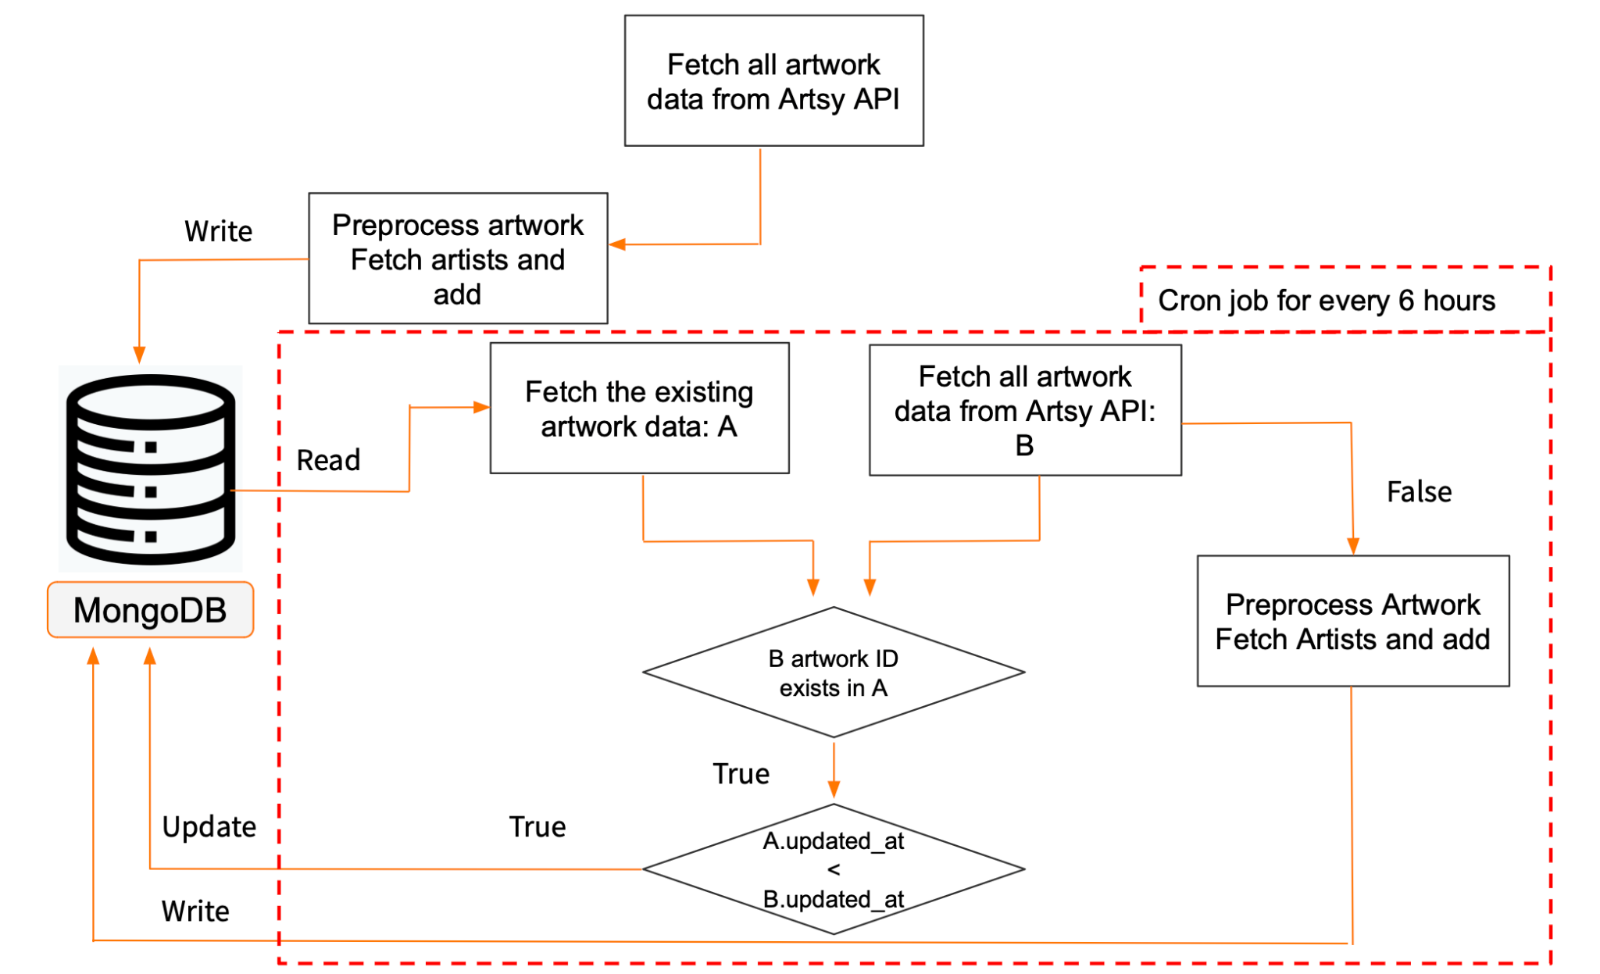
3.2 Data Pipeline
Source Dataset
Artsy Public API
Description
Size
55Mb (126070 records)
Document Type
JSON
Database maintenance
Initially fetch all artworks from the exposed Artsy API.
Preprocess and write it to mongo collection.
Add artists
Calculate word counts from the descriptions
Parse only useful fields
Have a CRON job to update the DB
Scheduled every 6 hours.
Fetch all artworks from Artsy.
Check if the each artwork already exists in the DB or if it is updated.
Update the DB accordingly

Slide 10

4 Implementation Showcase Video

Slide 11
Project Timeline
SWE Development
Implement backend and frontend components Integrate big data technologies
Product Planning
Define the project vision & scope
3/21 - 3/30
4/21 - Present
3/5 - 3/20
4/1 - 4/20
Figma Design
UI/UX Design
Product Development
Continuously refine README and source code

Slide 12
만나 DAO 의 첫 만남
5. Conclusion & Future Works
Categories
Description
Limitations
1
Lack of Price Data because of API access restrictions
2
Dependency on Third-Party APIs
Future Works
3
Securing Access to Artsy's Private API and Creating Price Database
4
Implementing Advanced Machine Learning Capabilities
5
Diversifying Data Sources and Enhancing Data Resilience
Conclusion
6
Our team is expanding; consider investing in our growth and innovation

Slide 13
Thank you

